Slide 1


Finite State Automaton (FSA) in Natural Language Processing
COURSE: NATURAL LANGUAGE PROCESSING
COURSE CODE: DSA0308
GUIDED BY:
Dr. KUMARAGURUBARAN. T
PRESENTED BY:
DHANYA SHREE AB(192472002)

Slide 2
Abstract
Natural Language Processing (NLP) enables computers to understand and process human language.
Finite State Automata (FSA) is one of the basic computational models used in NLP.
It recognizes input patterns by moving through a sequence of predefined states.
FSA is widely used for lexical analysis, tokenization, and regular expression matching.
It offers a simple and efficient method for processing textual data.
This presentation explains the concept, working principle, applications, advantages, and limitations of FSA in NLP.

Slide 3
Introduction
A Finite State Automaton (FSA) is a mathematical model used to recognize patterns and sequences of characters.
It consists of a finite number of states connected by transitions.
The automaton starts from an initial state and processes one input symbol at a time.
Based on the input, it moves between states according to predefined rules.
If the automaton reaches a final (accepting) state after processing the input, the input is considered valid.
FSA plays an important role in NLP applications such as lexical analysis, morphological parsing, and text pattern recognition.

Slide 4
Working, Components & Applications
Working of FSA
The automaton starts from the initial state.
It reads each input character sequentially.
The transition function determines the next state.
If the input reaches an accepting state, the string is accepted.
If no valid transition exists, the string is rejected.
The process continues until all input symbols are processed.
Main Components
States
Input Alphabet
Transition Function
Start State
Accept State
Applications
Tokenization
Spell Checking
Regular Expression Matching
Lexical Analysis
Morphological Parsing
Text Validation
.

Slide 5
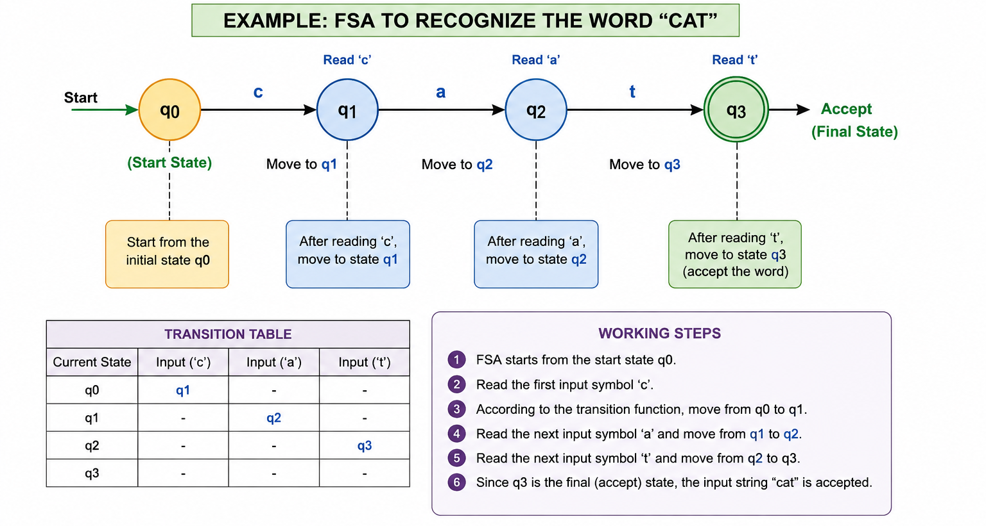
FLOW DIAGRAM

Slide 6
Advantages & Disadvantages
Disadvantages
Cannot understand the meaning of words.
Cannot process complex grammatical structures.
Limited to finite memory.
Does not handle context-dependent language.
Unsuitable for semantic analysis.
Less effective for complex NLP tasks.
Advantages
Fast and efficient for pattern recognition.
Simple to understand and implement.
Requires very little memory.
Provides accurate lexical analysis.
Supports regular expression processing.
Widely used in text processing applications.

Slide 7
Conclusion
Finite State Automata is a fundamental model in Natural Language Processing.
It recognizes words and patterns using states and transitions.
FSA provides fast and efficient text processing.
It is widely used in lexical analysis, spell checking, and tokenization.
Although it has limitations, it remains an essential building block in NLP.
Understanding FSA helps in learning advanced NLP concepts such as parsing and language modeling.

Slide 8

GEOTAG PHOTO

Slide 9
THANK YOU

